Slide 1
Knowledge Representation & Reasoning in AI
Week 6
Edward Ombui, PhD

Slide 2
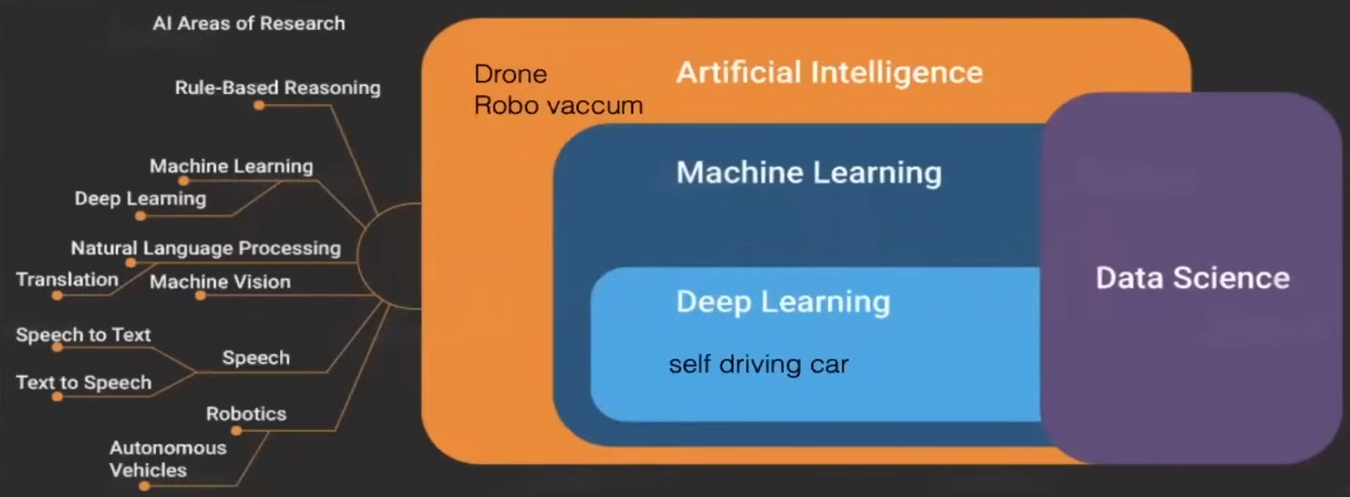

Slide 3
Lesson objective
By the end of this lesson, students should be able to understand the concepts of knowledge representation and reasoning using semantic networks and frames, and apply these concepts to solve problems in AI.

Slide 4
Lesson Learning Outcomes
Explain the concepts of semantic networks and frames as knowledge representation structures in AI
Demonstrate the ability to create semantic networks and frames to represent information in various domains.
Demonstrate reasoning skills by performing inference and deduction tasks using semantic networks and frames.

Slide 5
Knowledge Representation and Reasoning (KRR)
KRR is the part of Artificial intelligence which concerned with AI agents thinking and how thinking contributes to intelligent behavior of agents.
It is responsible for representing information about the real world so that a computer can understand and can utilize this knowledge to solve the complex real world problems E.g.
diagnosis a medical condition
communicating with humans in natural language.
It is also a way which describes how we can represent knowledge in artificial intelligence.
Knowledge representation is not just storing data into some database, but it also enables an intelligent machine to learn from that knowledge and experiences so that it can behave intelligently like a human.

Slide 6
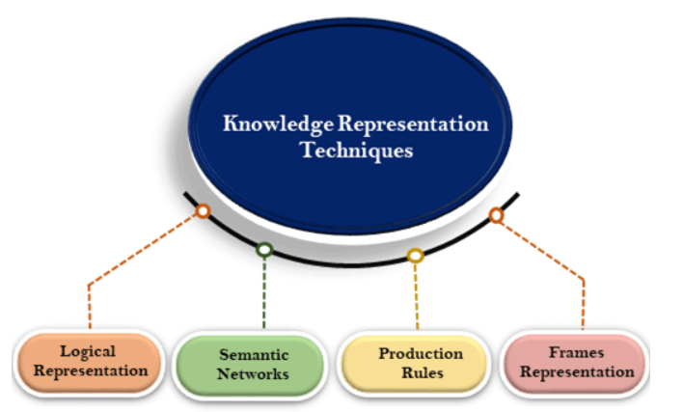

Slide 7
Knowledge Representation Structures
Facts: Simple statements about the world.
Rules: Statements that specify relationships or conditions.
Frames: Structures that organize knowledge about objects or concepts.
Semantic Networks: Graph structures representing relationships between entities.
Ontologies: Hierarchical structures defining concepts and their relationships.
Knowledge Graphs: Graph databases that connect entities and their relationships.

Slide 8
Logic Representation
Propositional Logic
Predicate Logic
Logic Representation
Advantages of Logical Representation
Logical representation enables us to do logical reasoning.
Logical representation is the basis for the programming languages.
Disadvantages
Logical representations have some restrictions and are challenging to work with.
Logical representation technique may not be very natural, and inference may not be so efficient.

Slide 9
Propositional Logic
A proposition is a declarative statement which is either true or false.
It’s a technique of knowledge representation in logical nad mathematical form
Example:
It is Monday
The Sun rises from North
2+4 <5
3 is a prime number.

Slide 10
Propositional Logic
Propositional logic is also called Boolean logic as it works on 0 and 1.
In propositional logic, we use symbolic variables to represent the logic, and we can use any symbol for a representing a proposition, such A, B, C, P, Q, R, etc.
Propositions can be either true or false, but it cannot be both.
Propositional logic consists of an object, relations or function, and logical connectives.
These connectives are also called logical operators.
The propositions and connectives are the basic elements of the propositional logic.
Connectives can be said as a logical operator which connects two sentences.
A proposition formula which is always true is called tautology, and it is also called a valid sentence.
A proposition formula which is always false is called Contradiction.

Slide 11
Example
A: It is hot
B: It is humid
C: It is raining
Condition:
If it is humid, then it is hot [Preposition :B ‐‐>A ]
If it is hot and humid then it is not raining [Preposition: A ∩ B ‐‐>C

Slide 12
Limitations of Propositional Logic
We cannot represent relations like ALL, some, or none with propositional logic. Example:
All the girls are intelligent.
Some apples are sweet.
Propositional logic has limited expressive power.
In propositional logic, we cannot describe statements in terms of their properties or logical relationships.

Slide 13
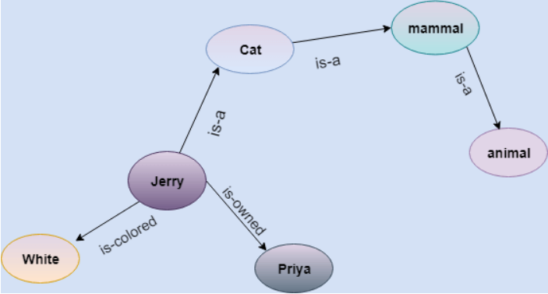
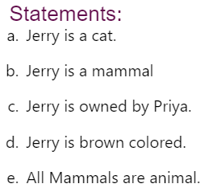
Semantic Network
A visual and intuitive knowledge representation technique consisting of a network of nodes (representing concepts, objects or entities) connected by edges (representing relationships or links).
Example: Following are some statements which we need to represent in the form of nodes and arcs.
Notes:
Advantages:
Semantic networks are a natural representation of knowledge.
Semantic networks convey meaning in a transparent manner.
These networks are simple and easily understandable.
Drawback:
Semantic networks take more computational time at runtime as we need to traverse the complete network tree to answer some questions. It might be possible in the worst case scenario that after traversing the entire tree, we find that the solution does not exist in this network.
Semantic networks try to model human-like memory (Which has 1015 neurons and links) to store the information, but in practice, it is not possible to build such a vast semantic network.
These types of representations are inadequate as they do not have any equivalent quantifier, e.g., for all, for some, none, etc.
Semantic networks do not have any standard definition for the link names.
These networks are not intelligent and depend on the creator of the system.

Slide 14
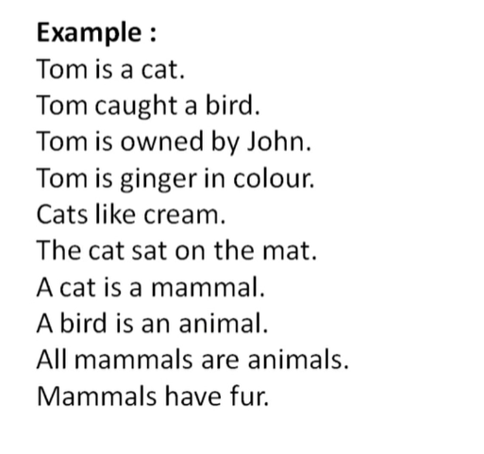
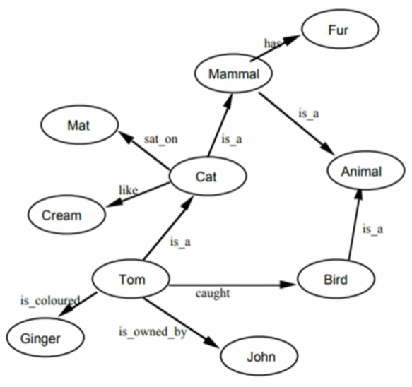

Slide 15
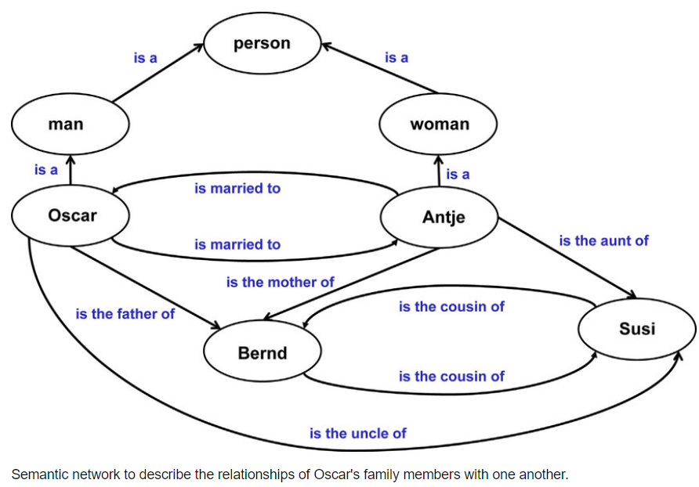

Slide 16
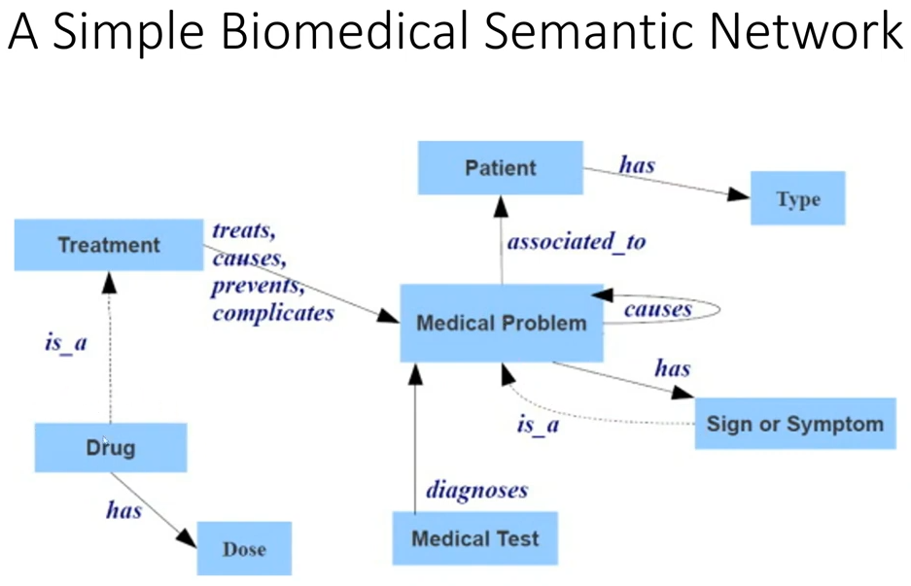

Slide 17
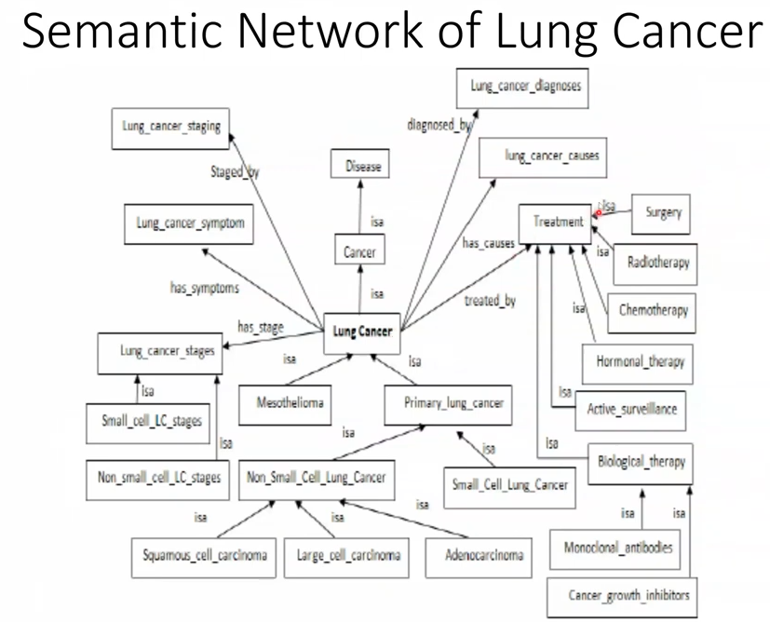

Slide 18
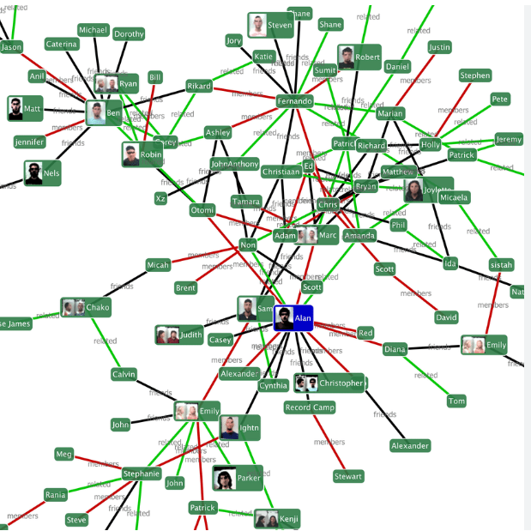
Visualizing Semantic Networks
https://www.visuwords.com

Slide 19
Advantages and Disadvantages
Advantages
Disadvantages
Semantic networks are a natural representation of knowledge.
Semantic networks convey meaning in a transparent manner.
These networks are simple and easily understandable
take more computational time at runtime
it is not possible to build a vast semantic network to model human like memory
they do not have any equivalent quantifier, e.g., for all, for some, none, etc
do not have any standard definition for the link names
Are not intelligent and depend on the creator of the system
Notes:
Advantages:
Semantic networks are a natural representation of knowledge.
Semantic networks convey meaning in a transparent manner.
These networks are simple and easily understandable.
Drawback:
Semantic networks take more computational time at runtime as we need to traverse the complete network tree to answer some questions. It might be possible in the worst case scenario that after traversing the entire tree, we find that the solution does not exist in this network.
Semantic networks try to model human-like memory (Which has 1015 neurons and links) to store the information, but in practice, it is not possible to build such a vast semantic network.
These types of representations are inadequate as they do not have any equivalent quantifier, e.g., for all, for some, none, etc.
Semantic networks do not have any standard definition for the link names.
These networks are not intelligent and depend on the creator of the system.

Slide 20
Exercise
Problem: Using a group of 5 to 7 friends who have different hobbies and interests, create a semantic network to represent the relationships between your friends and their hobbies.
Use Nodes to represent each friend, while their hobbies will be connected to them as linked nodes.
Each link will represent the relationship between the person and their hobbies.
Example Information:
John likes playing soccer and basketball.
Sarah enjoys reading books and painting.
Michael is interested in photography and hiking.
Emily's hobbies include playing the guitar and cooking.
David likes swimming and playing video games.
Notes:
John
Likes
Soccer
Basketball
Sarah
Likes
Reading books
Painting
Michael
Likes
Photography
Hiking
Emily
Likes
Playing the guitar
Cooking
David
Likes
Swimming
Playing video games

Slide 21
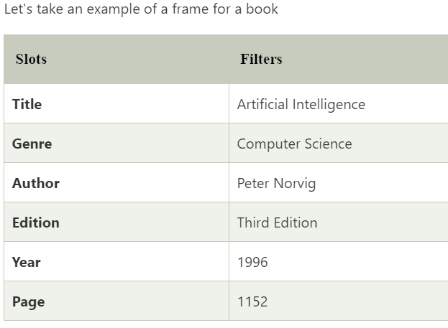
Frames
A frame is a data structure used to represent objects, concepts, or entities in a structured and organized manner.
Frames are derived from semantic networks and later evolved into our modern-day classes and objects.
A frame consists of slots (also known as attributes or properties) and fillers (also known as values) associated with those slots.
Each slot represents a specific aspect or characteristic of the object or concept being represented, and the fillers are the values associated with those characteristics.
Facets are features of frames which enable us to put constraints on the frames.
A frame is also known as slot-filter knowledge representation in artificial intelligence.
Application: expert systems, natural language understanding, and automated reasoning.
Notes:
Components of Frames: Explain the components of frames, including slots (attributes) and fillers (values).
Example Demonstration:
For example, consider a "Car" frame:
Slots: Make, Model, Year, Color, Engine Type, etc.
Fillers: Honda, Accord, 2022, Blue, Hybrid, etc.
Properties of Frames: Discuss properties such as default values, inheritance, and slot constraints in frames.
Exercise: Ask students to create frames for various objects or concepts, specifying slots and fillers.

Slide 22
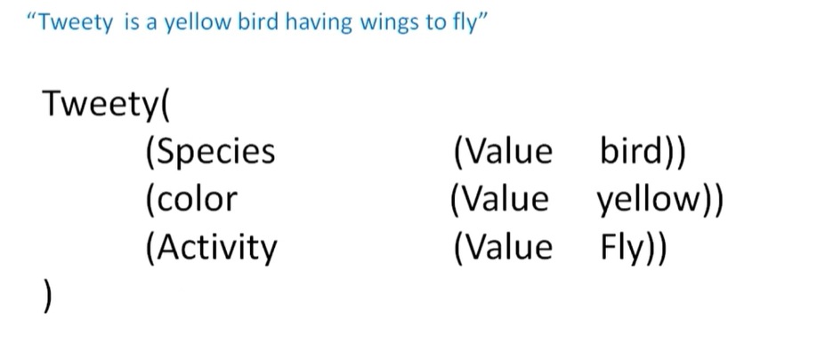

Slide 23
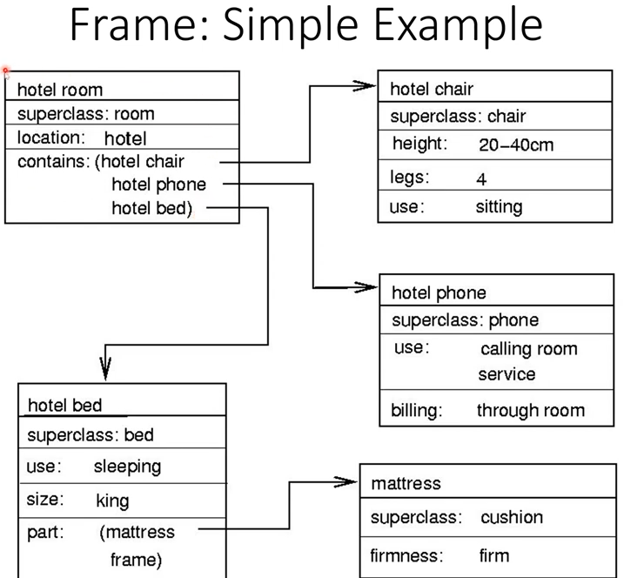

Slide 24
Advantages and Disadvantages
Advantages
The frame knowledge representation makes the programming easier by grouping the related data or knowledge (OOP)
The frame representation is comparably flexible and used by many applications in AI.
It is very easy to add slots for new attribute and relations. [Flexibility]
It is easy to include default data and to search for missing values.
Frame representation is easier to understand and visualize than logic or rules
Disadvantages
In frame system inference mechanism is not be easily processed.
Inference mechanism cannot be smoothly proceeded by frame representation.
Frame representation has a much generalized approach.

Slide 25
Exercise
Generate a frame representation for Paul
Paul is a Student at USIU university doing Software engineering as a major. His age is 23, he is from the city of Goma, in the country of DRC.

Slide 26
Other Semantic Network Related Representations
Concept Map
Topic Maps

Slide 27
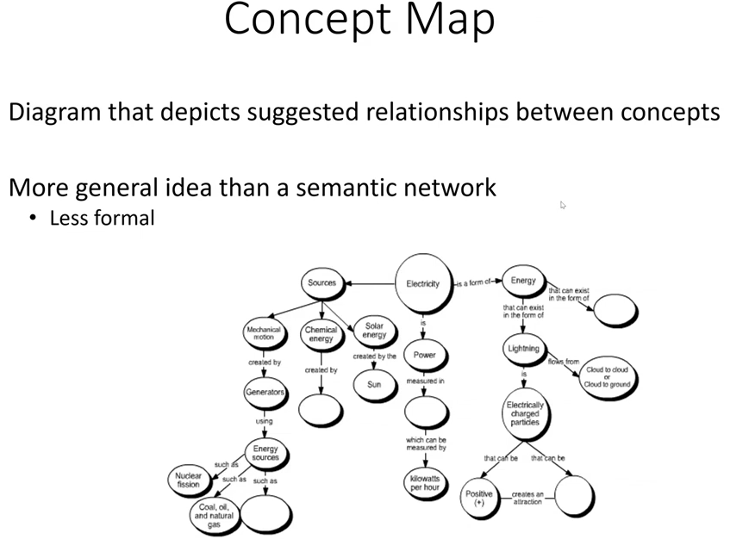

Slide 28
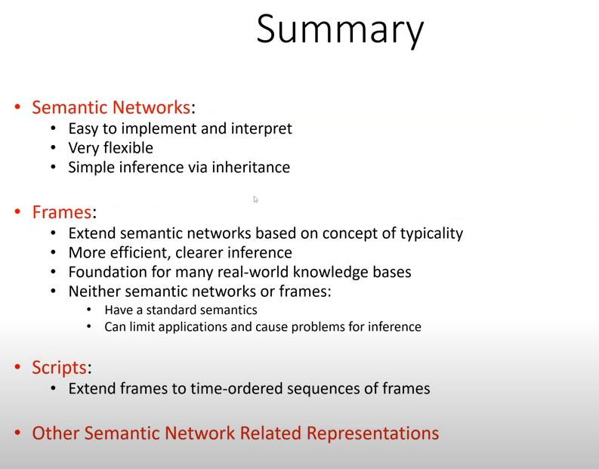

Slide 29
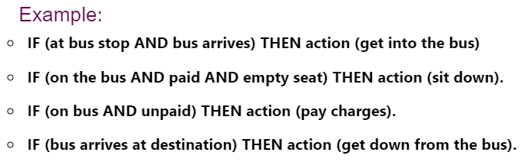
Production Rules
Production rules system consist of (condition, action) pairs which mean, "If condition then action". It has mainly three parts:
The set of production rules
Working Memory
The recognize-act-cycle
In production rules agent checks for the condition and if the condition exists then production rule fires and corresponding action is carried out.

Slide 30
Reasoning
A mental process of deriving logical conclusion and making predictions from available knowledge, facts, and beliefs.
"Reasoning is a way to infer facts from existing data." It is a general process of thinking rationally, to find valid conclusions.
Types of reasoning
Deductive reasoning
Inductive reasoning
Abductive reasoning
Causal Reasoning
Common Sense Reasoning
Monotonic Reasoning
Non-monotonic Reasoning
Notes:
Causal Reasoning: Causal reasoning involves identifying cause-and-effect relationships between variables or events. It's about understanding why something happens. For example:
Smoking causes lung cancer.
Therefore, if someone smokes, they are at higher risk of developing lung cancer.
Monotonic reasoning is a type of logical reasoning where the set of beliefs or assumptions remains constant or grows stronger as new information is added. I
These types of reasoning are not mutually exclusive, and often, multiple types of reasoning are used in combination to address complex problems or draw conclusions.

Slide 31
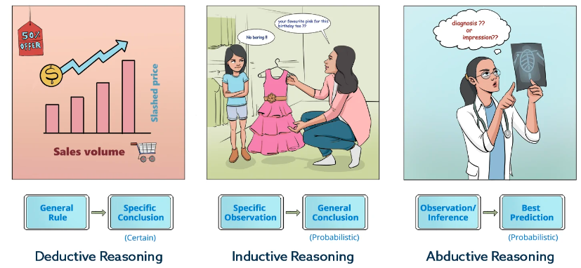
Types of Reasoning
Notes:
Deductive Reasoning: It's about deriving specific conclusions from general principles.
All humans are mortal. (Premise)
Socrates is a human. (Premise)
Therefore, Socrates is mortal. (Conclusion)
Inductive Reasoning: Inductive reasoning involves making generalizations based on specific observations. It's about forming probable conclusions based on evidence.
Every swan I've seen is white.
Therefore, all swans are white.
Abductive Reasoning: Abductive reasoning is about forming the best explanation for observed phenomena, even if it's not necessarily the most certain or logically guaranteed explanation. It's often used in scientific inference and problem-solving. For example:
There is water on the road.
The road is wet.
Therefore, it must have rained. (The inference of rain explains both the presence of water on the road and why the road is wet.)

Slide 32
References
https://www.javatpoint.com/knowledge-representation-in-ai
https://www.tutorialspoint.com/prolog/prolog_relations.htm

